Slide 1
HDDS1104 Operating Systems and Networking
Topic 1 - Introduction to Operating Systems

Slide 2
Intended Learning Outcomes
Describe the functions of Operating System (OS)
Distinguish between different types of OS
Describe the structures of OS
Discuss the functions of kernel services and system calls

Slide 3
Operating System Functionalities
Topic 1.1

Slide 4
What is an Operating System?
A program that acts as an intermediary between a user of a computer and the computer hardware
Operating system goals:
Execute user programs and make solving user problems easier
Make the computer system convenient to use
Use the computer hardware in an efficient manner

Slide 5
What Operating Systems Do
Users want convenience, ease of use and good performance
Don’t care about resource utilization
But shared computer such as mainframe or minicomputer
must keep all users happy
Users of dedicate systems such as workstations
dedicated resources but frequently use shared resources from servers
Handheld computers
resource poor, optimized for usability and battery life
Some computers have little or no user interface,
such as embedded computers in devices and automobiles

Slide 6
Operating System Definition
OS is a resource allocator
Manages all resources
Decides between conflicting requests for efficient and fair resource use
OS is a control program
Controls execution of programs to prevent errors and improper use of the computer

Slide 7
Operating System Definition (Cont.)
No universally accepted definition
“Everything a vendor ships when you order an operating system” is a good approximation
kernel
“The one program running at all times on the computer”
Everything else
a system program or
an application program.

Slide 8
Types of Operating systems
Topic 1.2

Slide 9
Computing Environments
Traditional
Mobile
Virtualization
Emulation
Cloud computing
Other OS

Slide 10
Traditional Computing Environment
Stand-alone general purpose machines
But blurred as most systems interconnect with others (i.e., the Internet)
Portals provide web access to internal systems
Network computers (thin clients) are like Web terminals
Mobile computers interconnect via wireless networks
Networking becoming ubiquitous – even home systems use firewalls to protect home computers from Internet attacks

Slide 11
Computing Environments - Mobile
OS for handheld smartphones, tablets, etc
Extra feature
more OS features (GPS, gyroscope)
Allows new types of apps like augmented reality
Example: Apple iOS, Google Android

Slide 12
Virtualization
Allows operating systems to run applications within other OSes
Vast and growing industry
Virtualization – OS natively compiled for CPU, running guest OSes also natively compiled
Consider VMware running Windows guests, each running applications, all on native Windows host OS
VMM (virtual machine Manager) provides virtualization services

Slide 13
Virtualization vs Emulation
Emulation used when
source CPU type different from target type
(i.e. Intel x86 to ARM)
Generally slowest method
When computer language not compiled to native code – Interpretation

Slide 14
Virtualization - Use cases
laptops / desktops running multiple OSes
for exploration or compatibility
Use cases
Apple laptop running Mac OS X host, Windows/Linux as a guest
Developing apps for multiple OSes without having multiple systems
QA testing applications without having multiple systems
Executing and managing compute environments within data centers
Virtual Machine Manager can run natively, (i.e. also the host)
no general-purpose host
E.g. VMware ESX and Citrix XenServer

Slide 15
Virtualization

Slide 16
Cloud Computing
Delivers computing, storage, even apps as a service across a network
Logical extension of virtualization
Many types
Public cloud – available via Internet to anyone willing to pay
Private cloud – run by a company for the company’s own use
Hybrid cloud – includes both public and private cloud components

Slide 17
Service Models in Cloud Computing
Software as a Service (SaaS) – one or more applications available via the Internet (i.e., word processor)
Platform as a Service (PaaS) – software stack ready for application use via the Internet (i.e., a database server)
Infrastructure as a Service (IaaS) – servers or storage available over Internet (i.e., storage available for backup use)

Slide 18
Cloud Computing environments
composed of
traditional OSes
VMMs
cloud management tools
Internet connectivity requires security
like firewalls
Load balancers
spread traffic across multiple applications

Slide 19
Cloud Computing

Slide 20
Other Computing Environments
Distributed
Collection of separate systems networked together
Client-server computing
Peer-to-Peer
Real-time Embedded System
Open-source vs closed-source

Slide 21
Operating System Structures
Topic 1.3

Slide 22
Components of Computer System
Users
People, machines, other computers
Hardware
provides basic computing resources
CPU, memory, I/O devices
Operating system
Controls and coordinates use of hardware among various applications and users
Application programs
define the ways in which the system resources are used to solve the computing problems of the users

Slide 23
Components of Computer System
User
User
User
System Program
Application Program
Application Program
System Program
Operating System
Hardware
Hardware
Hardware

Slide 24
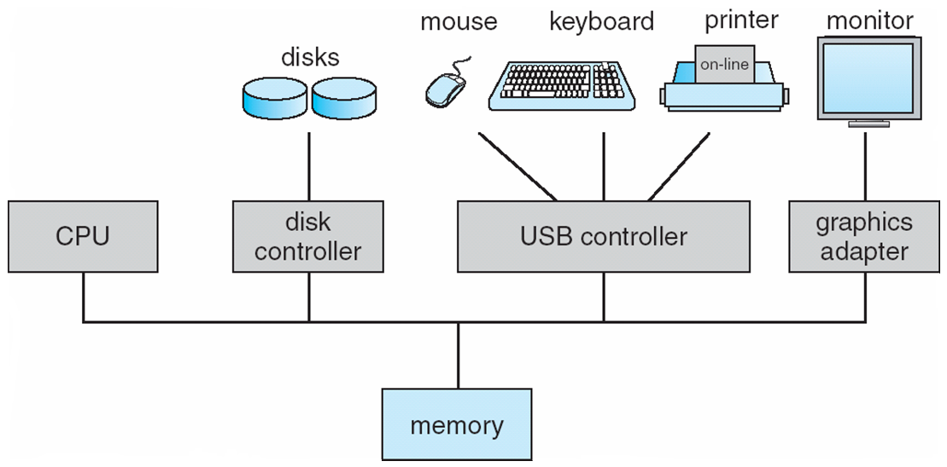
Hardware
Computer-system operation
One or more CPUs, device controllers connect through common bus providing access to shared memory
Concurrent execution of CPUs and devices competing for memory cycles

Slide 25
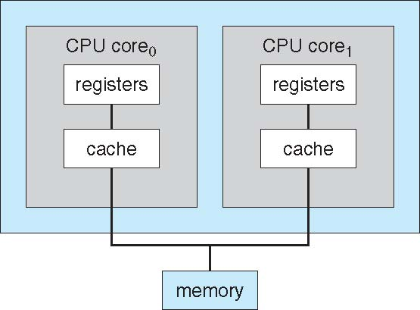
A Dual-Core Design
Multi-chip and multicore
Systems containing all chips
Chassis containing multiple separate systems

Slide 26
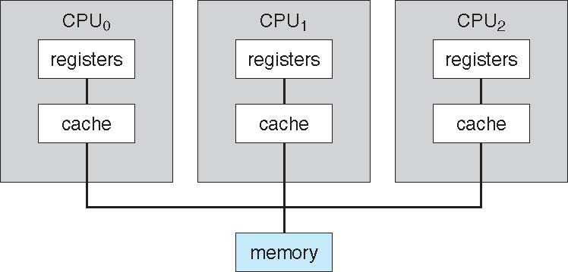
Symmetric Multiprocessing Architecture

Slide 27
Computer-System Operation
I/O devices and the CPU can execute concurrently
device controller
in charge of a particular device type
has a local buffer
CPU moves data from/to main memory to/from local buffers
I/O is from the device to local buffer of controller
Device controller informs CPU that it has finished its operation by causing an interrupt

Slide 28
Storage Structure
Main memory
only large storage media that the CPU can access directly
Secondary storage
provides large nonvolatile storage capacity
Examples
Hard disks
Solid-state disks

Slide 29
Storage Hierarchy
Storage systems organized in hierarchy
Speed
Cost
Volatility
Caching – copying information into faster storage system; main memory can be viewed as a cache for secondary storage
Device Driver for each device controller to manage I/O
Provides uniform interface between controller and kernel

Slide 30
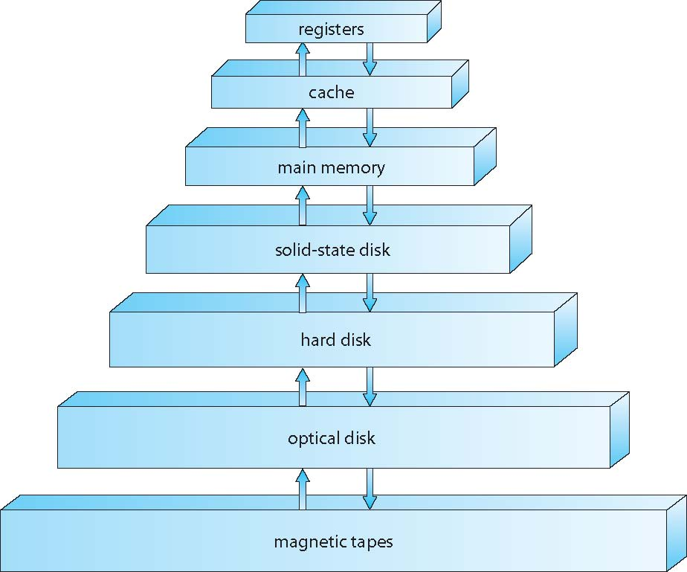
Storage-Device Hierarchy

Slide 31
Caching
Important principle, performed at many levels in a computer (in hardware, operating system, software)
Information in use copied from slower to faster storage temporarily
Faster storage (cache) checked first to determine if information is there
If it is, information used directly from the cache (fast)
If not, data copied to cache and used there
Cache smaller than storage being cached
Cache management important design problem
Cache size and replacement policy

Slide 32
System call & Kernel service
Topic 1.4

Slide 33
Kernel
Startup
Interrupt Handling
Kernel Mode

Slide 34
Computer Startup
bootstrap program is loaded at power-up or reboot
Typically stored in ROM or EPROM, generally known as firmware
Initializes all aspects of system
Loads operating system kernel and starts execution

Slide 35
Common Functions of Interrupts
Interrupt transfers control to the interrupt service routine generally, through the interrupt vector, which contains the addresses of all the service routines
Interrupt architecture must save the address of the interrupted instruction
A trap or exception is a software-generated interrupt caused either by an error or a user request
An operating system is interrupt driven

Slide 36
Interrupt Handling
The operating system preserves the state of the CPU by storing registers and the program counter
Determines which type of interrupt has occurred:
polling
vectored interrupt system
Separate segments of code determine what action should be taken for each type of interrupt

Slide 37
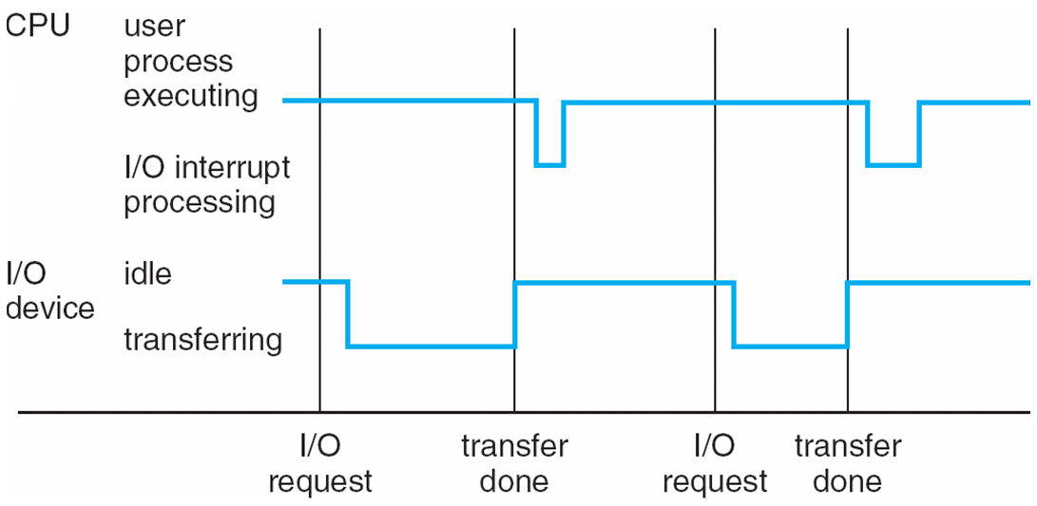
Interrupt Timeline

Slide 38
I/O Structure
After I/O starts, control returns to user program only upon I/O completion
Wait instruction idles the CPU until the next interrupt
Wait loop (contention for memory access)
At most one I/O request is outstanding at a time, no simultaneous I/O processing
After I/O starts, control returns to user program without waiting for I/O completion
System call – request to the OS to allow user to wait for I/O completion
Device-status table contains entry for each I/O device indicating its type, address, and state
OS indexes into I/O device table to determine device status and to modify table entry to include interrupt

Slide 39
Operating-System Operations
Interrupt driven (hardware and software)
Hardware interrupt by one of the devices
Software interrupt (exception or trap):
Software error (e.g., division by zero)
Request for operating system service
Other process problems include infinite loop, processes modifying each other or the operating system

Slide 40
Operating-System Operations (cont.)
Dual-mode operation allows OS to protect itself and other system components
User mode and kernel mode
Mode bit provided by hardware
Provides ability to distinguish when system is running user code or kernel code
Some instructions designated as privileged, only executable in kernel mode
System call changes mode to kernel, return from call resets it to user
Increasingly CPUs support multi-mode operations
i.e. virtual machine manager (VMM) mode for guest VMs

Slide 41
Transition from User to Kernel Mode
Timer to prevent infinite loop / process hogging resources
Timer is set to interrupt the computer after some time period
Keep a counter that is decremented by the physical clock.
Operating system set the counter (privileged instruction)
When counter zero generate an interrupt
Set up before scheduling process to regain control or terminate program that exceeds allotted time

Slide 42
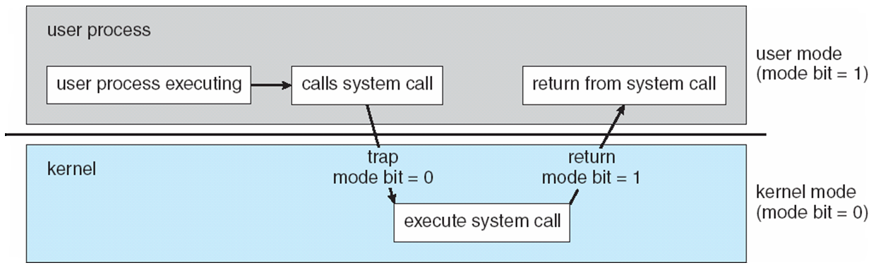
Transition from User to Kernel Mode

Slide 43
Introduction to OS functions
Process Management
CPU scheduling
Memory Management
Input/Output (I/O) management
File Management

Slide 44
Protection and Security
Protection – any mechanism for controlling access of processes or users to resources defined by the OS
Security – defense of the system against internal and external attacks
Huge range, including denial-of-service, worms, viruses, identity theft, theft of service
Systems generally first distinguish among users, to determine who can do what
User identities (user IDs, security IDs) include name and associated number, one per user
User ID then associated with all files, processes of that user to determine access control
Group identifier (group ID) allows set of users to be defined and controls managed, then also associated with each process, file
Privilege escalation allows user to change to effective ID with more rights

Slide 45

End of Week 1

